Slide 1
Elasticsearch
Presented By: Scott Harris and Noah Dunn

Slide 2

Introductory Information
System Name: Elasticsearch
Primary Database Model: Search Engine Database
Host Company: Elasticsearch B.V (AKA Elastic).
URL: Link to the Company

Slide 3


The Authors
Scott Harris:
Noah Dunn:

Slide 4

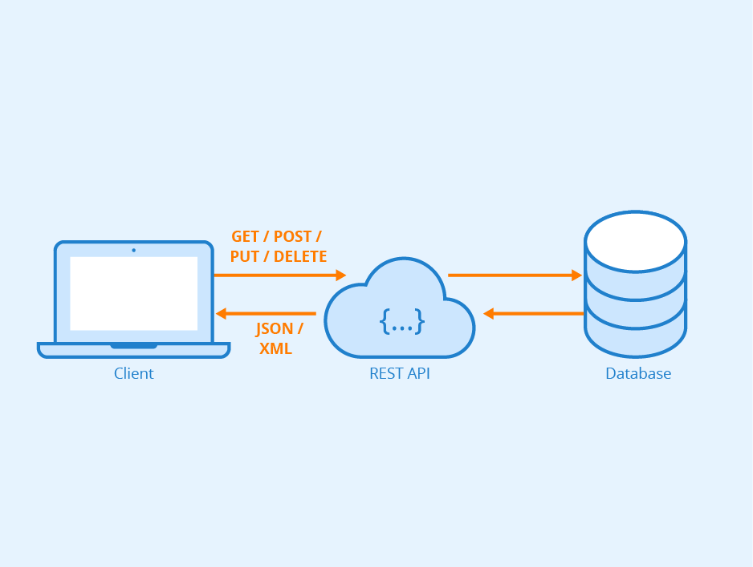

System Overview
History
Based on Apache Lucene
First released in 2010
Intended Usage
REST API
Retrieving Small Doses of Information
Website Searching
Focus on Read Operations
Special Feature(s)
Fuzzy or Incomplete Querying
Optimized for Data Retrieval
Document Store

Slide 5
Document Store
Elasticsearch Instance
{
"id": "0",
"name": "Trivial Document 0",
"description": "I am a very simple Document"
}
Elasticsearch makes use of JSON Document-Store format
The ‘Database’ consists of the entire collection of all Documents
Much like Mongo or other NoSQL solutions, these documents are unstructured and can contain a wide array of keys and values
{
"id": "1",
"name": "Trivial Document 1",
"description": "I am a very simple Document"
}
{
"id": "2",
"worm": "doodle",
}

Slide 6
Sharding Visual
Data Retrieval, sent to client
All Database Processing in Elasticsearch is done via what are called ‘shards’
Shards are processing units of various sizes that can handle retrieval for queries
Shards can merge together or split for increased distribution or increased processing power
Shards provide ‘fault-tolerance’. If one process fails, the other shards will pick up the slack
{
"id": "0",
"name": "Trivial Document 0",
"description": "I am a very simple Document"
}
{
"id": "1",
"name": "Trivial Document 1",
"description": "I am a very simple Document"
}
Query
Shard
Failure
Successful
Query
Filtering
{
"id": "2",
"worm": "doodle",
}

Slide 7
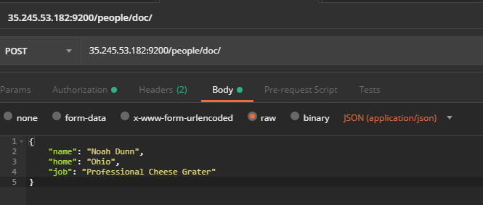
INSERT Query Example

Slide 8
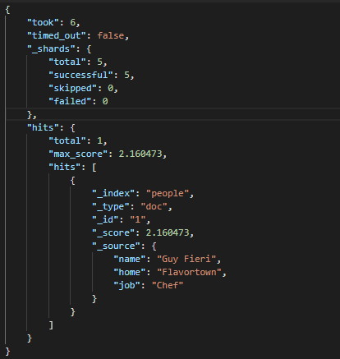
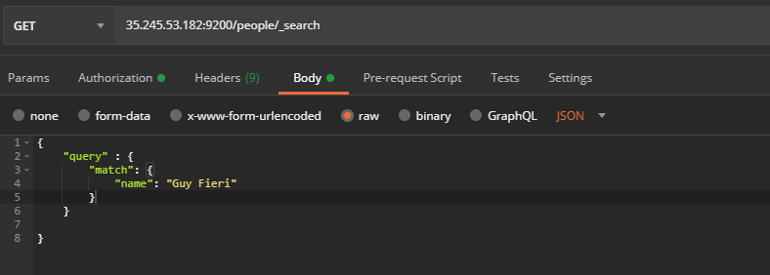
SELECT Query Example

Slide 9
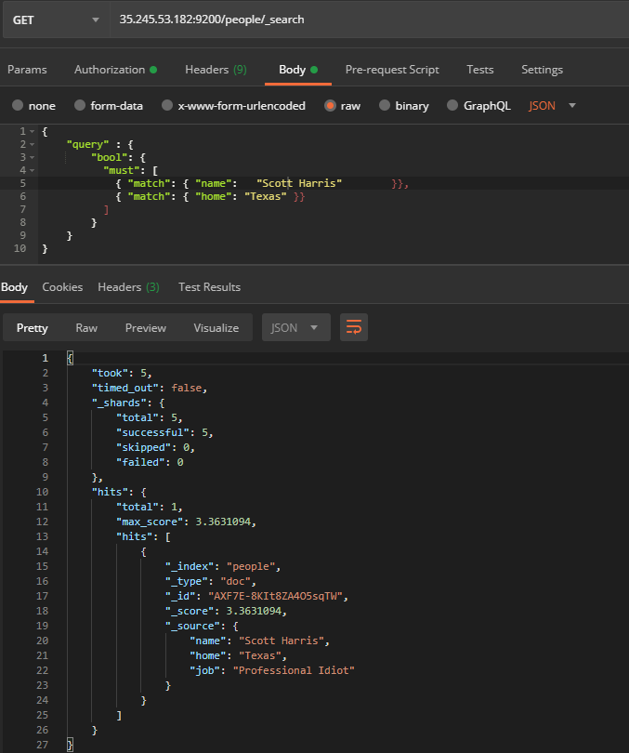
Multi-Conditional Querying

Slide 10
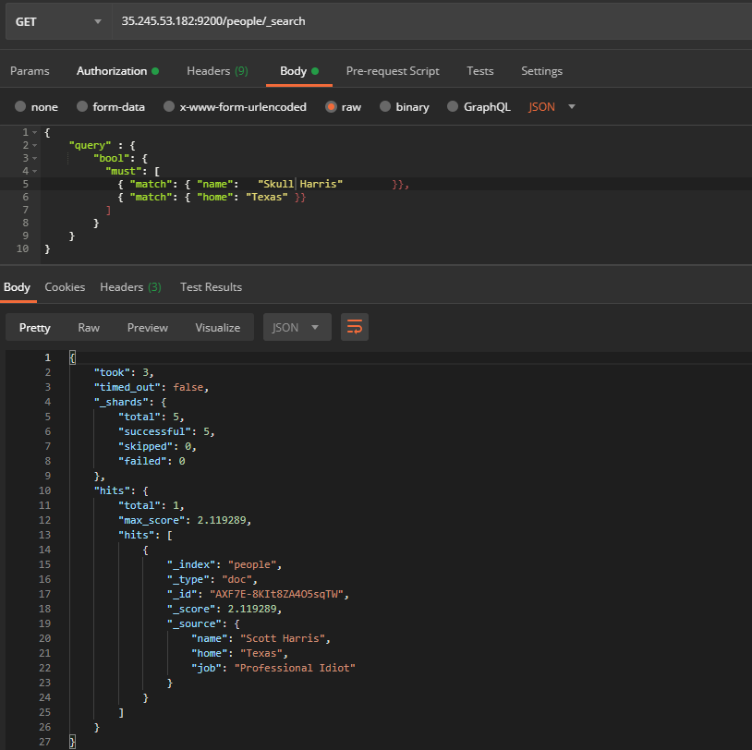
Fuzzy Matching Example

Slide 11
Links, Description, Relevant Documentation
Official Website
https://www.elastic.co/
Querying Documentation
https://www.elastic.co/guide/en/elasticsearch/reference/current/index.html
A More Complex Look at Sharding
https://buildingvts.com/elasticsearch-architectural-overview-a35d3910e515
Guide: Installation to Querying
https://medium.com/@factoryhr/elasticsearch-introduction-implementation-and-example-17dd66c35c35
Link to Where to Get Install Packages
https://www.elastic.co/guide/en/elasticsearch/reference/current/install-elasticsearch.html

Slide 12
Challenges, Issues, Things to keep in mind
Things Elasticsearch doesn’t do well or at all
Deletion (Finicky)
Joining different documents (Not possible from our research)
Bulk insertion
There is no custom client offering. Everything is done in REST calls, which can be a negative to those unfamiliar with HTTP or REST.
Potential DevOPS Issues
Google Cloud consumes credit for an instance very quickly
Local Installs have to be manually started for use
Shard allocation can lead to consuming a large portion of CPU
When Querying
There are at least two ways to write each query: POST body call, and URL modification
Do what you find easier

